Slide 1
File handling and dictionaries
Shannon Turner
Twitter: @svthmc

Slide 2
Review Lesson Two
Learn how to read info from files
Learn how and when to use dictionaries
Using everything we've learned so far: strings, slicing, conditionals, lists, loops, file handling, dictionaries

Slide 3
Lightning review
Lists can hold multiple items at once
List of attendees
List of days in the week
List of months in the year
Slicing allows us to view individual (or multiple) items in a list
The in keyword allows us to check whether a given item appears in that list
Notes:
If you haven't taken attendance yet, please do so now, and write out people's names on the whiteboard.

Slide 4
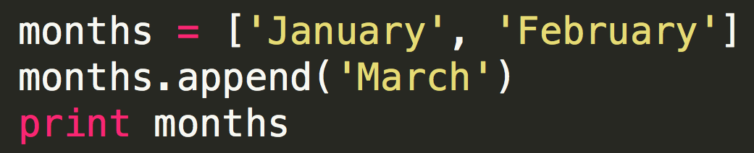
Lightning revieW
.append() adds one item to the end of a list
.pop() removes one item from the end of a list
Notes:
So if we popped here, we'd be back to a list with two items in it: January and February.

Slide 5
Lightning revieW
Use .split() on a string to turn it into a list
Notes:
Use your hands and "chop" on the commas.
Of course you can split using other characters besides commas -- it all depends on what the separator is in your string.

Slide 6
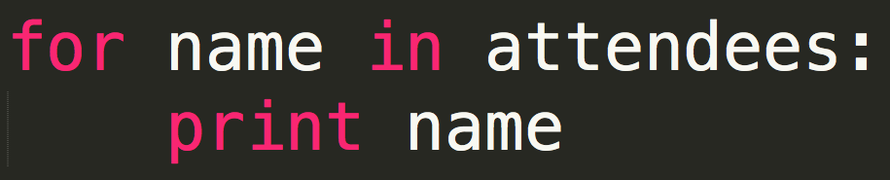
Lightning review
Loops allow us to write code once but have it run multiple times
For loops: for each item in this list, do something
Notes:
We're already very familiar with for loops -- we do it every time we take attendance: for each person in the room, stand up, say your name.
Have folks stand up for attendance again using the for loop.

Slide 7
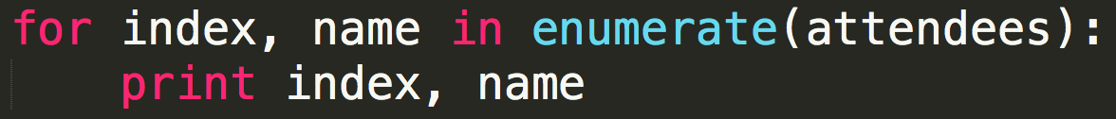
Lightning review
enumerate() works with for loops to give you the position of the list item and the list item itself at the same time
Notes:
Have folks stand up for attendance again, this time also giving their position in the list as well as their name.

Slide 8
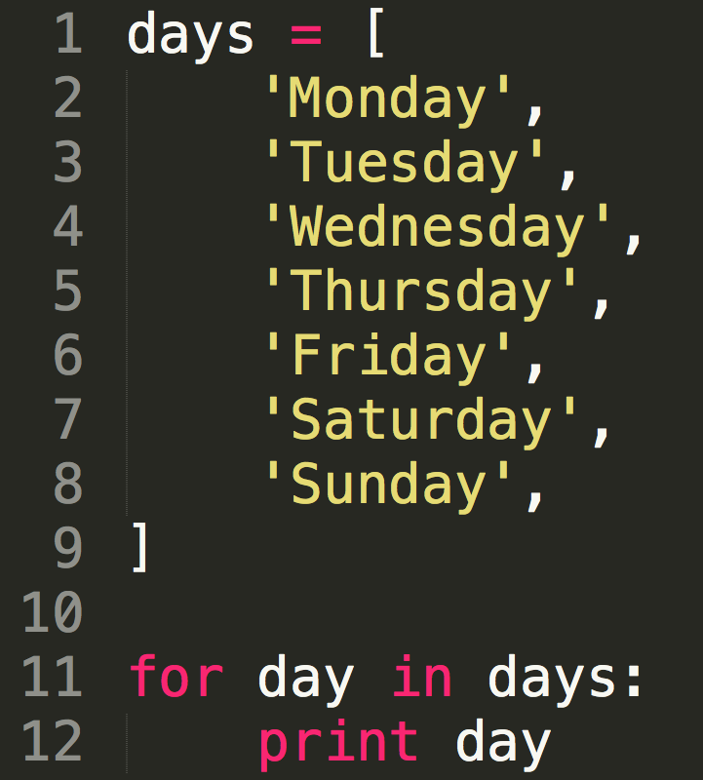
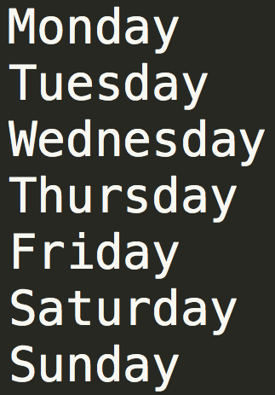
Lightning review
Notes:
Let's take another look at another for loop that we're already familiar with.
Give attendees enough time to try this out.

Slide 9
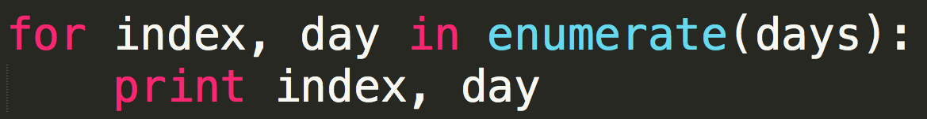
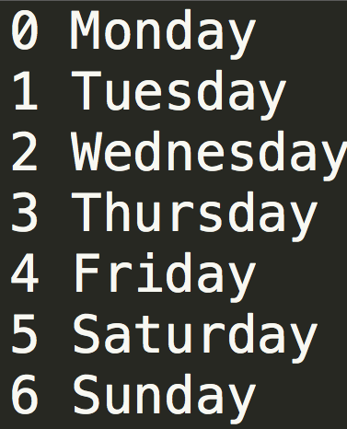
Lightning review
Notes:
And here's the same loop, with enumerate.
Give attendees enough time to try this out.

Slide 10
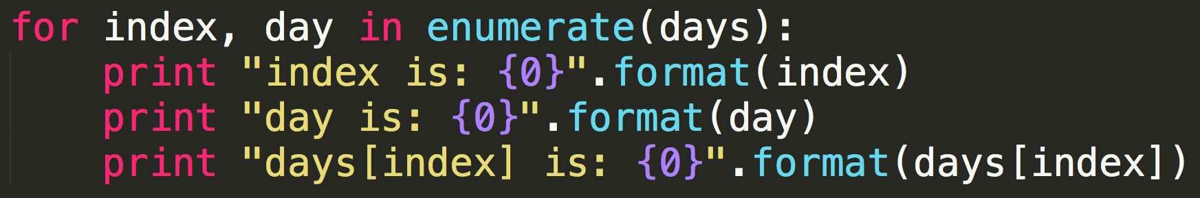
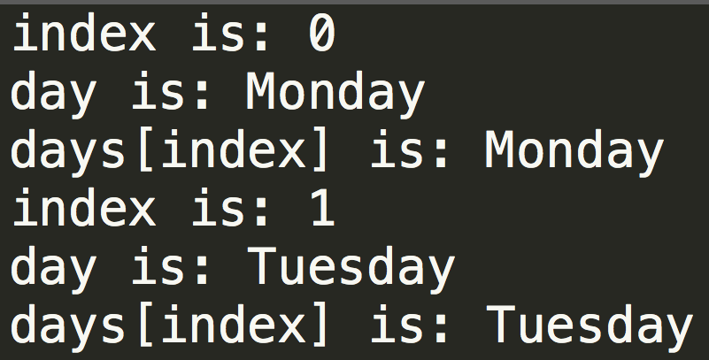
Lightning review
Notes:
Let's take a closer look at what's going on. Let's all try this out.
Notice how day is the same as days[index].
Remember: when in doubt, print it out!

Slide 11
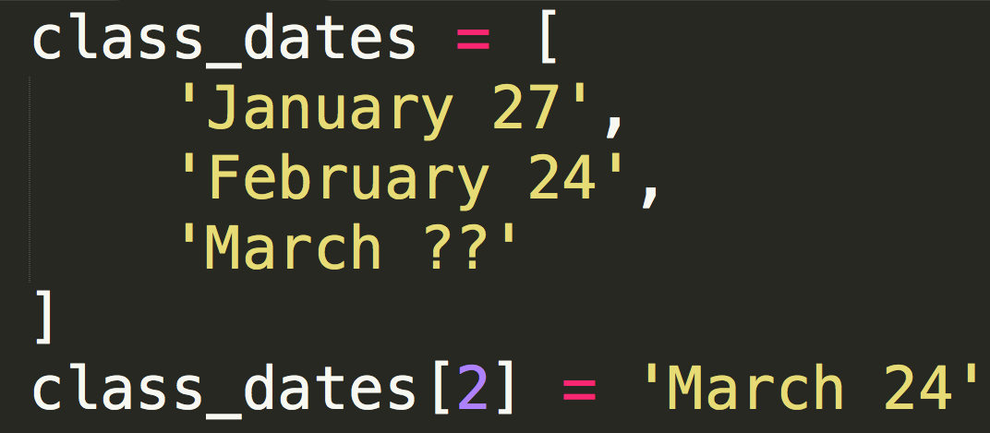
Editing lists
You can change individual list items if you know their position/slicing number.
Notes:
Now that we know the date for March, we'll edit the last list item in the list class_dates.

Slide 12
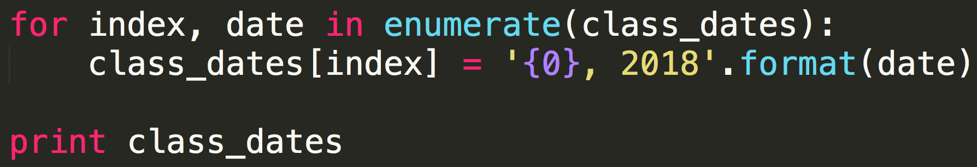
editing lists with enumerate
You can use this concept with enumerate() to edit every list item:
Notes:
Why do we say class_dates[index] = <new string> instead of date = <new string>, if class_dates[index] and date are equivalent?
Well, date gets a new value at the beginning of each phase in the for loop, so if we changed date, our changes would be lost when the value changed from January 27 to February 24. But we can edit the list directly by specifying the index we want to change, and then our changes will stick.

Slide 13
file handling
File handling lets Python read and write to files
Read from or write to a spreadsheet
Read from or write to a text file

Slide 14
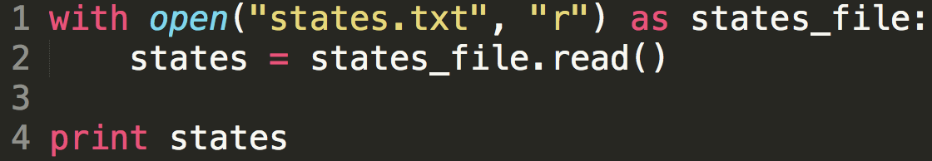
file handling: most common syntax
with keyword: tells Python we're going to do something with a file we're about to open.
When all commands within the indentation have been run, the file is closed automatically.
Notes:
In the next few slides, we'll be exploring each part of the syntax individually.
We'll be going through these slides pretty quickly.
You might see other syntaxes for opening files in Python, but I like this one because you don't have to remember to close your files when you're done with them; it's done automatically.

Slide 15
file handling: most common syntax
open() is a built-in function that tells Python to open a file.
Argument 1: The file you want to open.
Notes:
This example assumes that your file states.txt lives in the same folder as your Python script. If that's not true, you will need to tell Python exactly where to find your file. To make things easier on yourself, put them in the same folder.

Slide 16
file handling: most common syntax
open() tells Python to open a file.
Argument 2: The "mode" to open the file in, as a string
r: read-only mode
w: write mode
a: append mode
Notes:
Read-only mode allows you to read from the filename you specify.
Write mode writes to the filename you specify. If the file already exists, it will be overwritten -- you will lose its previous contents!
Append mode is safer to use than write mode -- if the file already exists, anything you write will be added to the end of the file. If the file does not exist yet, it behaves like write mode.

Slide 17
file handling: most common syntax
The as keyword creates a variable for your file handler.
The variable in this example is states_file, but you could use any variable name you want.
Notes:
Remember that we like to use variable names that are meaningful and that make sense to us so that when we look back at our code (or if someone else is reading it), it's easy to understand.

Slide 18
file handling: most common syntax
.read() is a file method — a function that only works with file handlers. In this example, the file handler is states_file.
.read() will read the entire contents of the file. In line 2 above, I've saved it into the variable states.

Slide 19
file handling: most common syntax
Outcome:
Open a file (states.txt)
Create a variable called states that has the entire contents of the file states.txt
Notes:
Hey Python, can you open up this file? Great! Can you save the full contents of this file into a variable? Awesome, thanks!

Slide 20
Let's try it out
In the python-lessons repo, go to section_07_(files)
Copy/paste or save states.txt onto your computer, in the same folder as your Python script.
Write a script to open states.txt and print the contents of the file.
Notes:
Show folks they can click directly on the states.txt link above to open it in a way that's easily copy-pasteable. Get states.csv too while you're at it.

Slide 21
file handling: most common syntax
The variable states is a string containing the contents of your file states.txt.
Notes:
This slide is really just to recap everything we just did (especially since we had so much new syntax we learned).

Slide 22
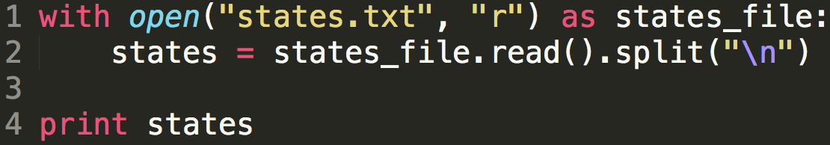
Let's try it out: text files
.read() gives us the file contents as a string. If we have a string, we can turn it into a list using .split()!
states is now a list rather than a string.
Notes:
Here, the only thing we changed from the previous example was adding
.split("\n")
Take the time to have everyone try it for themselves.

Slide 23
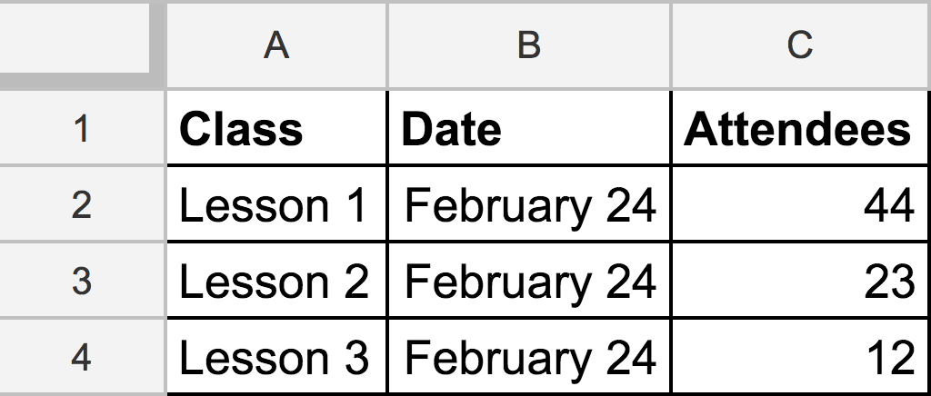
We can open spreadsheets too
Notes:
Let's say we have this spreadsheet, with some facts about classes.

Slide 24
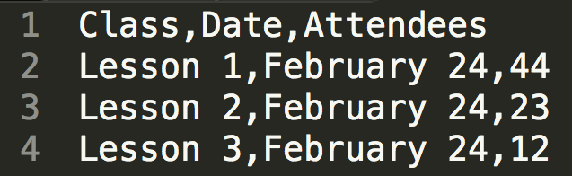
csv = comma separated values
Notes:
If we saved this spreadsheet as a CSV file (which stands for comma separated values), here's what it would look like.

Slide 25
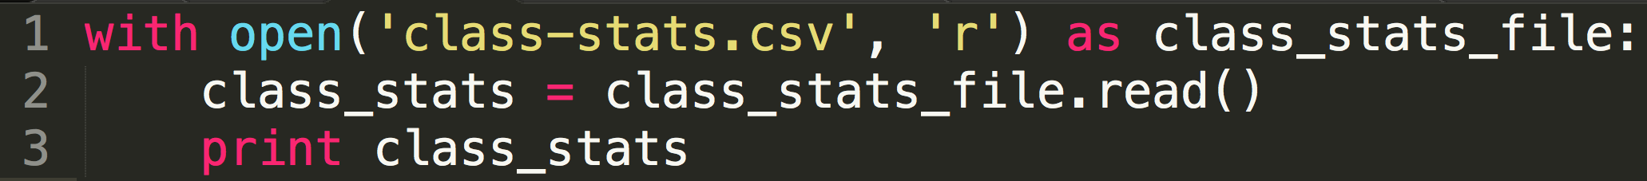
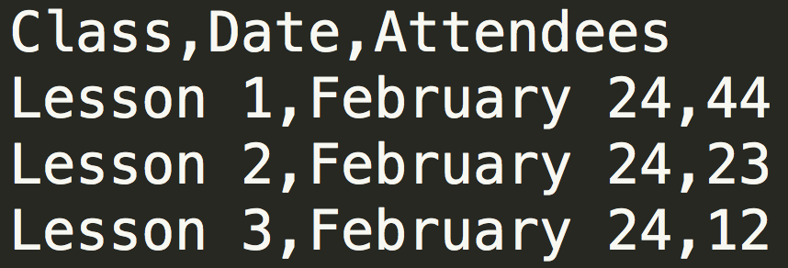
we start the same as with a text file
Let's open this CSV file and read from it
Notes:
We opened the CSV file in exactly the same way as we opened the text file.
And we'll step through this process little by little, adding a bit of code as we go.

Slide 26
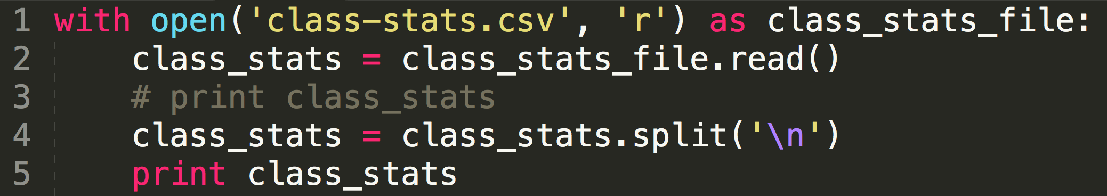
then split on the newlines
Only lines 4 and 5 are new.
Notes:
We split the file up by newlines, so now we have a list with four items in it.
Class/Date/Attendees (the header); Details about lesson 1; details about lesson 2; details about lesson 3.
In the previous example, we added the .split() to the end of line 2, but I'm doing it across multiple lines here so we can see everything step by step.

Slide 27
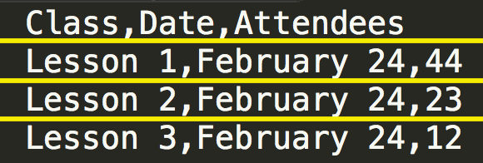
Another way to picture it

Slide 28
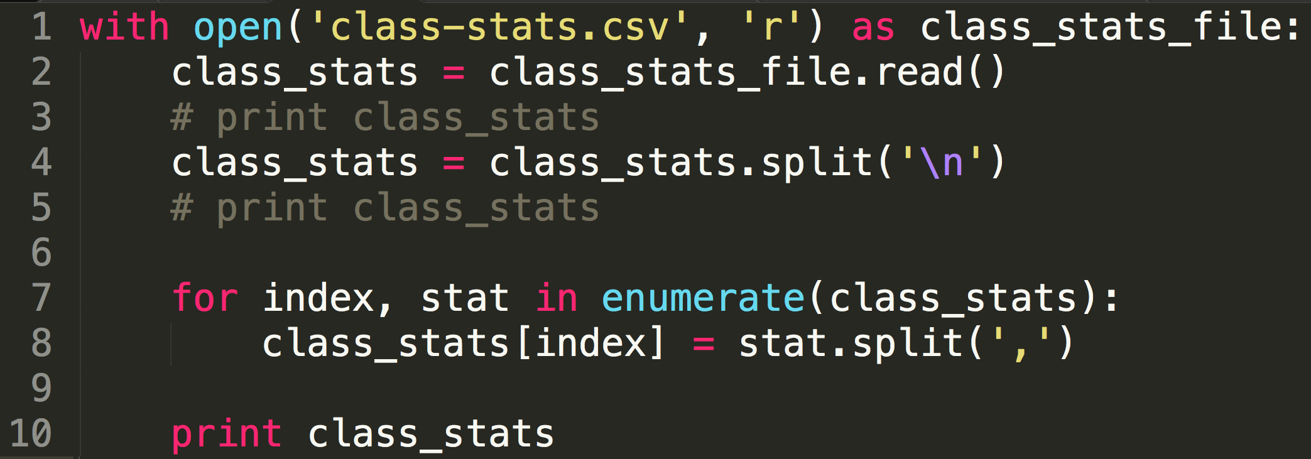
csv = comma separated values
Only lines 7-10 are new.
Notes:
We split the file up by newlines, so now we have a list with four items in it.
Class/Date/Attendees (the header); Details about lesson 1; details about lesson 2; details about lesson 3

Slide 29
Let's take a closer look
Notes:
It's the same code but let's take a closer look at lines 7-8 and what's happening in that loop.
Point to each item: class_stats[0], class_stats[1], class_stats[2], class_stats[3]

Slide 30
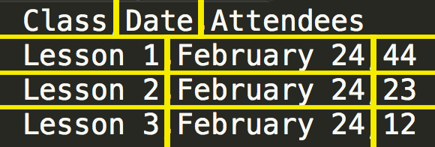
Another way to picture it
Notes:
All of the code up top is the same as on the previous two slides.

Slide 31
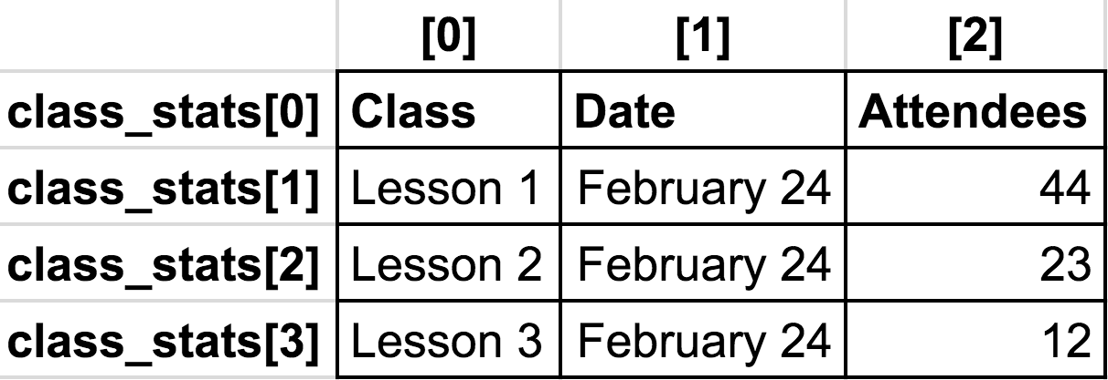
how to get to ITEMS IN A NESTED LIST
class_stats[0] is a list
class_stats[0][0] is a string
Notes:
Think about it this way: each row is one class, and each column tells us one fact about that class. Which lesson was it? When was it held? How many people attended?
Have participants try lots of different slices, and try it from multiple directions:
If I wanted to get the string "Lesson 2" what slices do I need? class_stats[2][0]
If I wanted the number of attendees for Lesson 3 (which is 12), what slices do I need? class_stats[3][2]
If I wanted everything about lesson 1, which slice do I need? class_stats[1]

Slide 32
why use python for spreadsheets?
Compare attendance
Lesson and class size separated out
What is the average size of lesson 1?
What was the lowest class size?
The highest?
How many lesson 2s have I run?
What is the difference in class sizes between lessons?
Notes:
Let's assume I have a big spreadsheet with more than just three classes in it.
These questions would have been very time-consuming to process by hand, especially if there are a lot of records but Python can do them very quickly.

Slide 33
why use python for spreadsheets?
Given a spreadsheet of petition signatures, create a nicely-formatted document to send to the printer
Bulk import records into a database
Turn a spreadsheet of museum locations into a map: https://shannonvturner.com/museums
Notes:
And it's not just for data analysis! Here are some other things I've done with Python and spreadsheets.
Petitions: In my day job, we often have petition signatures that we are delivering to Congress. But a spreadsheet of petition signatures isn't very useful. So I take a spreadsheet that has a person's name, city, state, and their comment, and loop through each person's signature and create a new document out of it, one that looks nicely formatted and is readable by a person.
Events: We often also need to bulk import records into a database because it would take a long time to add them manually. To put events into our events system manually, you need to add the title, the venue, the date, the time, the description, how many people, all kinds of information about the event. Adding them one by one into the system is a lot of clicks and typing. It's very easy to make mistakes. And a lot of the time, a lot of the event information is the same. So a spreadsheet is actually ideal here. I put all of that same information -- venue, time, date, description, etc -- into a spreadsheet. And then I have a Python script that will import all of those into our Events database system.
Mapping Museums: The Institute of Museum and Library Sciences released a spreadsheet of all of the museums in the US, which is cool, but I was surprised that there wasn't a map of it. But since they released all of the data in a spreadsheet, I was able to use Python to not only create a map of all of the museums, but an interactive map where you could click on a pin to find out more information about each museum.
In each of these cases, the rows in the spreadsheets are the main item:
one petition signature; one event; one museum.
And the columns are one fact about each of those things:
who signed the petition; where they lived.
where the event is held; when the event is held.
where the museum is located; what type of museum is it.

Slide 34
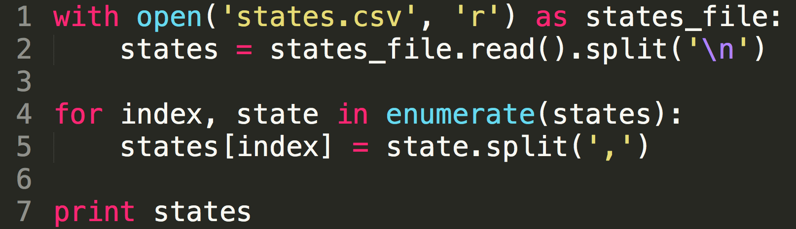
Let's try it out: csv files
In line 5, we split each row into its columns and make those changes stick. We end up with a nested list by line 7.
Notes:
Go back and download states.csv from https://raw.githubusercontent.com/shannonturner/python-lessons/master/section_07_(files)/states.csv if you haven't yet.
We need to use enumerate in order to get the position; then we overwrite the list as we loop through it.
At line 2, we split a string into a list; then item by item we loop through that list (the rows) and split out the columns and save it.
Remember that in line 5, states[index] is identical to state -- if you're having difficulty picturing what's going on, add print statements. When in doubt, print it out! Print index, print states[index], print state, print states[index] again after we've made the change.
By line 7, we see that we have a nested list of lists.

Slide 35
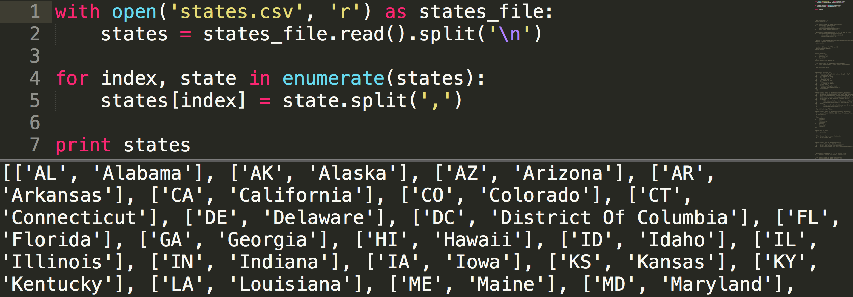
lists within lists
This nested list (a list of lists) is a list of each US state. The lists inside have the abbreviation and state name.
Notes:
Again, notice how each row is one state, and each column is a fact about that state: its abbreviation, its full name.

Slide 36
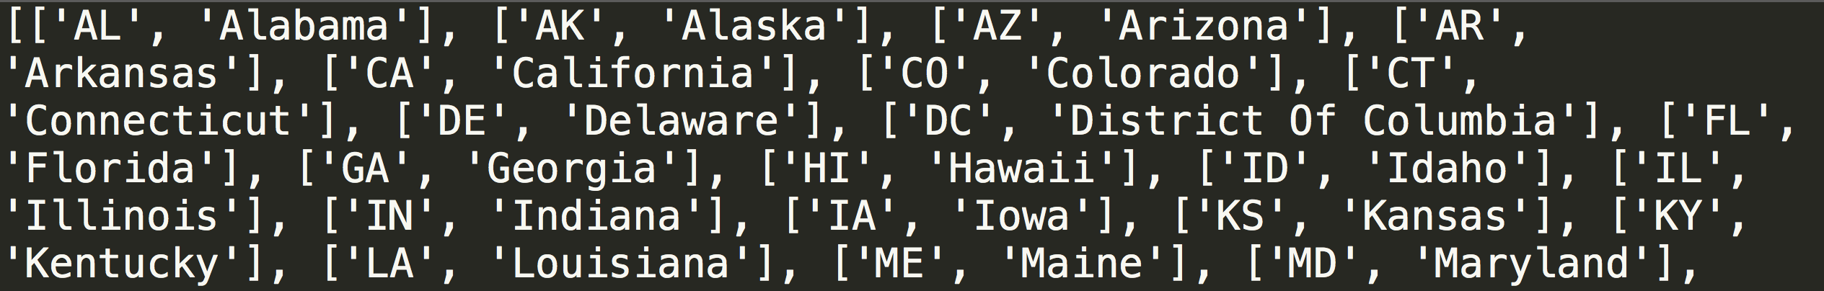
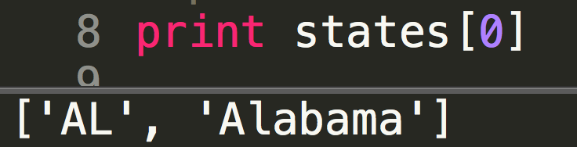
lists within lists
We're already familiar with how to view one item in a list:

Slide 37
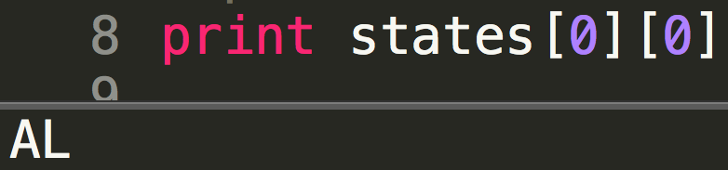
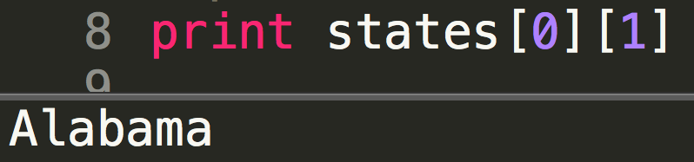
lists within lists
But states[0] is also a list! So to view one item in the states[0] list:
or

Slide 38
lists within lists
What type of object is states? A list.
What type is states[0]?
What type is states[0][1]?
Can I slice those things to see a smaller part?

Slide 39
Exercise: part one
Building from the previous slide, open states.csv and loop through to create two lists:
One with all of the state names
Another with all of the abbreviations.
Break everything into smaller steps, run and test often!
Notes:
On the previous slide, we left off with a nested list.
But the insides of that nested list contain the state abbreviations and the state names in a predictable way. The first column (slice 0) will always contain the abbreviations; the second column (slice 1) will always contain the state names.

Slide 40
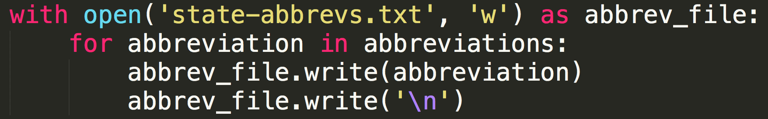
Exercise: part two
Loop through your two lists to write their contents to two files:
One with all of the state names
Another with all of the abbreviations.
Notes:
Note that you'll need the "w" flag (second parameter) to write to a file.
Your code to write to a file will look a little something like this.

Slide 41
dictionaries: why
How would we …
Create a list of names and Github handles for each student in the class
If we wanted to look up a specific person's Github handle, how could we do that?
… there's got to be a better way
Notes:
Open up Sublime Text and start to create a list. Talk through how to do this without dictionaries, we'd have to loop through every single item and check to see if it's the one we're looking for.

Slide 42
dictionaries: perfect for contact lists
Dictionaries are another way of storing information in Python.
Dictionaries have two components: a key and its corresponding value.
Think of it like a phone book or contact list! If you know my name, (key) you can look up my number (value)!
Notes:
Throwaway joke: eventually no one will know what a "phonebook" is.

Slide 43
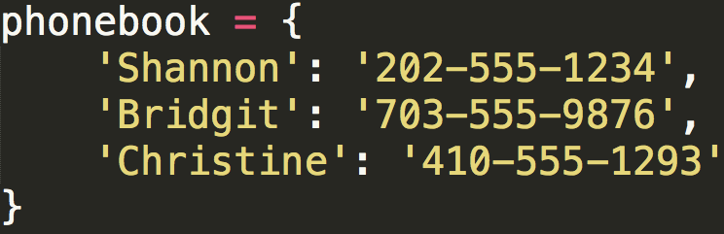
Creating a dictionary
Creating an empty dictionary:
phonebook = {}
Creating a dictionary with items in it:
Notes:
Use your hands and reinforce key:value. If you know my name, you can look up my phone number.

Slide 44
reading part of a dictionary
Reading part of a string:
name[0:5] # Shann
Reading part of a list:
attendees[:3] # Amy, Jen, Julie
Reading part of a dictionary:
phonebook['Shannon'] # 202-555-1234
Notes:
Emphasize the similarities between slicing a string, slicing a list, and accessing a dictionary. In each case, the syntax uses square brackets and allows us to see part of the larger whole.
What happens if you try to slice a list with an invalid index? (IndexError)
What happens if you try to read a dictionary with an invalid key? (KeyError)
Talk about how these are similar.

Slide 45
adding to a dictionary
Add an item to a dictionary:
phonebook['Mel'] = '301-555-1111'
Dictionaries are unordered.
The order of your dictionary may change as you add or remove items!
Notes:
To add an item to a dictionary, we need to tell Python its key and its value.
Don't take my word for it! Print out your phonebook dictionary and see -- are the items in the same order you added them?

Slide 46
real phonebooks are a bit more complex
In your phone's contacts app, what fields might you find?
Name
Organization
Phone number (and type)
Email
Address
... a whole lot more
Notes:
These are all facts about one person! And they're stored in your phone as a dictionary.

Slide 47
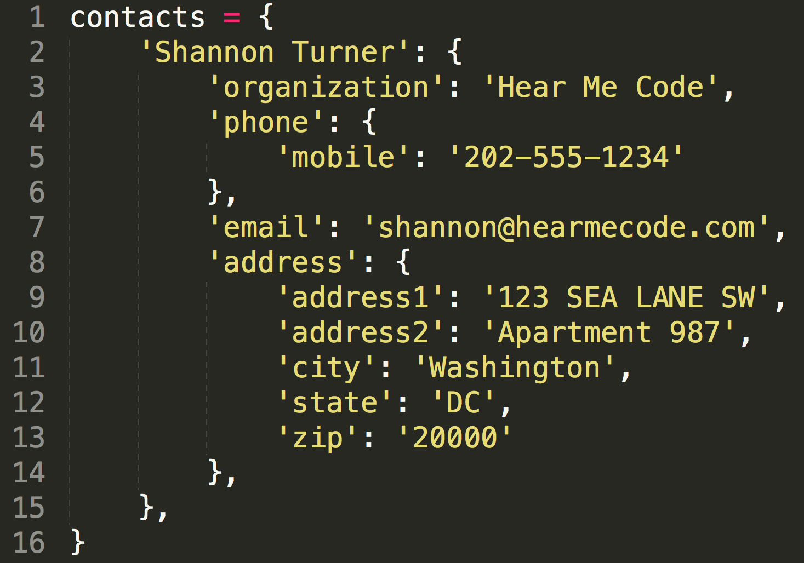
real phonebooks are complex
Notes:
There's a lot of information here! First things first: this is a dictionary with just a single key: "Shannon Turner" There's only one contact in this phonebook! Remember that dictionaries are key-value pairs. And that value is a dictionary itself, which has lots of facts about that person.

Slide 48
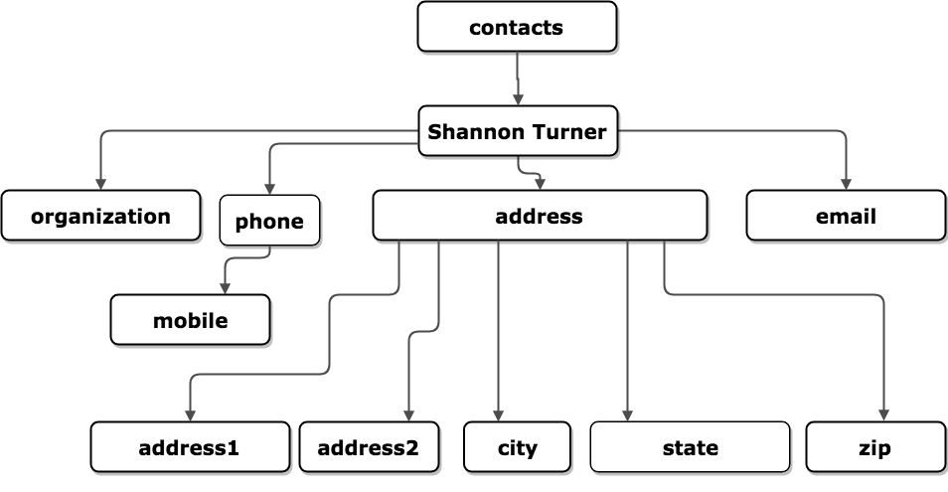
Let's visualize it differently
Notes:
And here's that exact same dictionary, but represented in a way that might be easier for us to recognize.

Slide 49
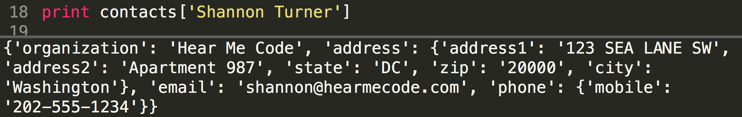
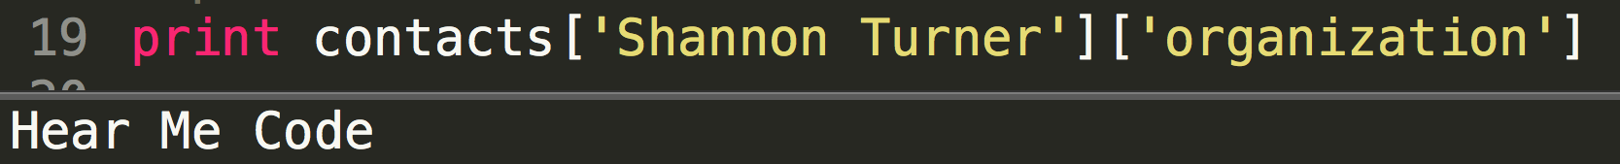
"Slice" it like a nested list
We have a dictionary within a dictionary:
Just keep slicing:
Notes:
How might we slice the dictionary to get my phone number?
How might we slice the dictionary to get my apartment number?

Slide 50
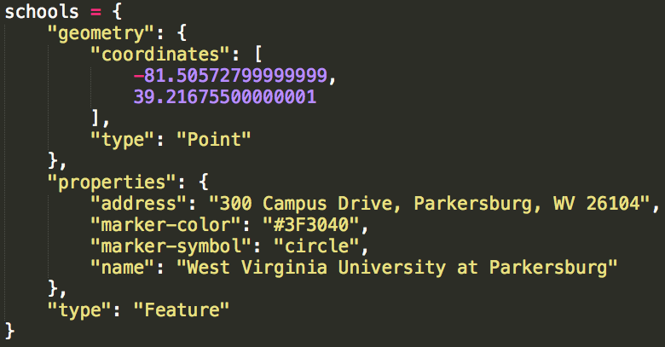
dictionaries can contain ...
... strings, lists, even other dictionaries!
Notes:
Walk through each key / value pair and point out every single thing in this dictionary.

Slide 51
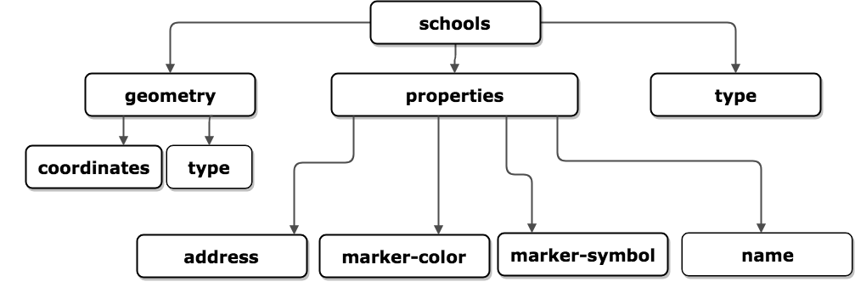
Let's visualize it differently
Notes:
And here's that exact same dictionary, but represented in a way that might be easier for us to recognize.

Slide 52
exercise
Save these exercise instructions to your computer, open it in Sublime/IDLE and work from there!
Notes:
Walk folks through saving the file in their Sublime Text / IDLE.

Slide 53
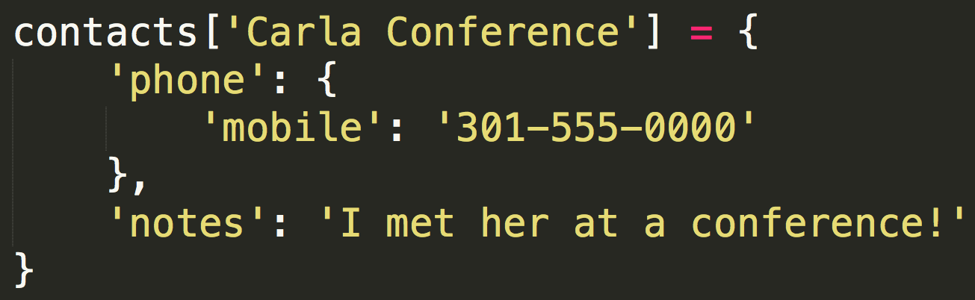
Dictionaries are flexible
We just met Carla, so we don't have as many details about her in our phonebook as we do for Shannon.
Notes:
We only have her mobile phone number and a quick note we wrote to ourselves in her contact record. But that's totally okay. Dictionaries are flexible.

Slide 54
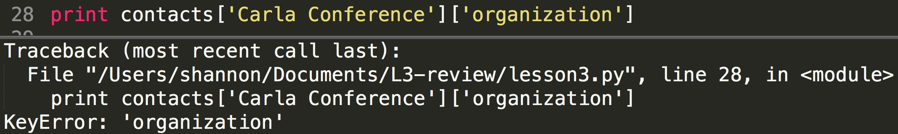
I don't have that key
Notes:
Which organization was she with again? Oops, we don't actually have that in our records. When we try to ask, Python tells us "KeyError: organization."
Kinda like when we get an IndexError trying to slice a list using a slicing number that doesn't exist in that list, a KeyError is Python's way of saying: I don't have that information. I don't have that fact about that person.

Slide 55
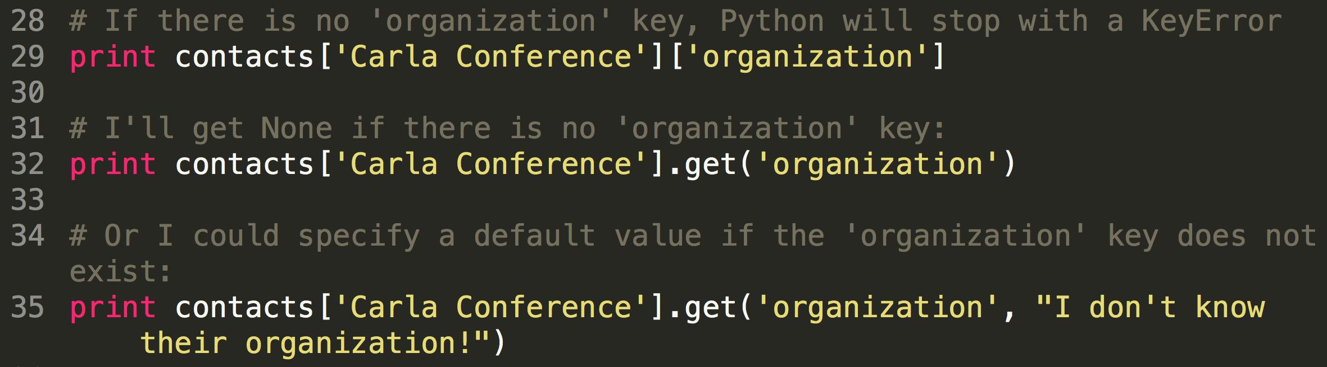
use .get( ) to keep going
When you get a KeyError, your program stops. That's not always what you want.
Notes:
Here we have three options. We already know the first option will give us a KeyError if there isn't an organization associated with someone.
But that would be pretty inconvenient if our phone's contacts app crashed whenever it didn't have data for someone. To be more flexible, we can use .get( ) to see if the key exists. If it does, it'll return the value as normal. If not, Python will continue with no error. Try this out for yourself and see what happens.

Slide 56
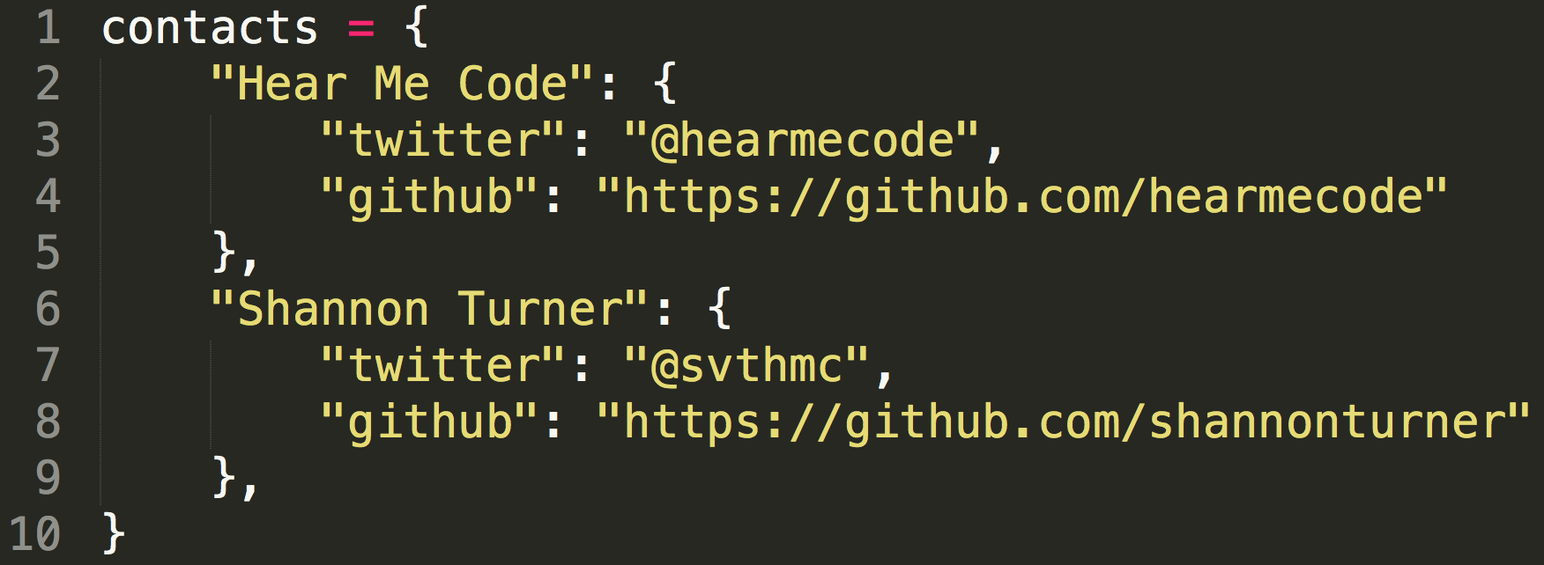
exercise
Save these exercise instructions to your computer, open it in Sublime/IDLE and work from there!
Just do #1 for now. Once we've added items to our dictionary, we'll see how to loop through it in the next slides.

Slide 57
looping through a dictionary
Let's loop through the contacts list we just created. We have a handful of ways to do this.
Looping by keys (Shannon, Hear Me Code, everyone else at your table…)
Looping by key / value pairs together

Slide 58
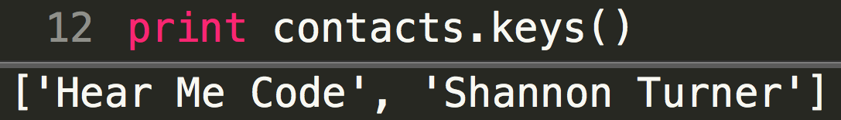
.keys( ) creates a list
.keys() creates a list of all of the keys in your dictionary.
Because dictionaries are unordered, you might get keys in a different order than you see below, or a different order than you put them in. That's okay.

Slide 59
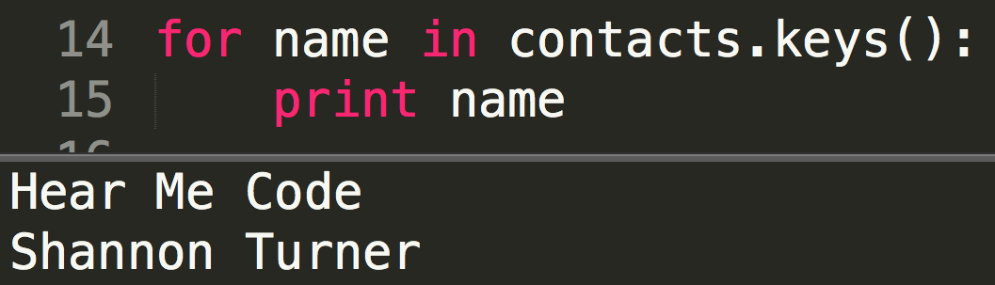
we can loop over a list!
.keys() will create a list of all of the keys in your dictionary.
If you have a list, you can loop over it!

Slide 60
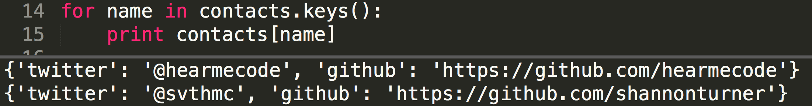
we can loop over a list!
.keys() will create a list of all of the keys in your dictionary.
If you have a list, you can loop over it!
Notes:
In the previous slide, we just looped through the keys.
Now let's use those keys to see what values they correspond to.

Slide 61
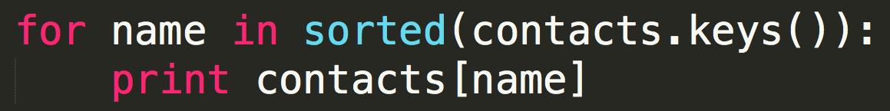
dictionaries are unordered
Dictionaries themselves have no ordering, but we can order their keys:
sorted()is a built-in function that sorts a list.
Notes:
Re-emphasize that you cannot rely on the ordering of a dictionary, you can only order lists of its keys.

Slide 62
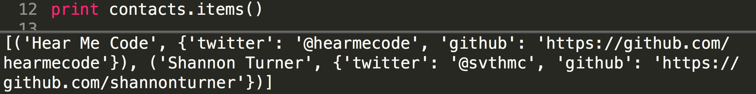
.items( ) creates a list of key/value pairs
.items() will create a list of all of the key/value pairs in your dictionary.
As with .keys(), if we have a list, we can loop over it. .items() gives us a list of lists!
Notes:
Remind everyone that dictionaries are unordered, so you might see things in a different order and that's okay.

Slide 63
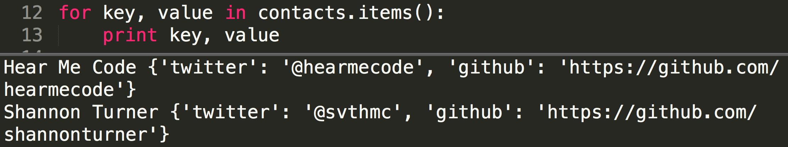
.items( ) creates a nested list
.items() will create a list of all of the key/value pairs in your dictionary.
Notes:
Here, I've named my variables "key" and "value" to illustrate that dictionaries use a key: value pair for the dictionary items.
I wanted to illustrate that for teaching purposes, but let's use meaningful variable names instead.

Slide 64
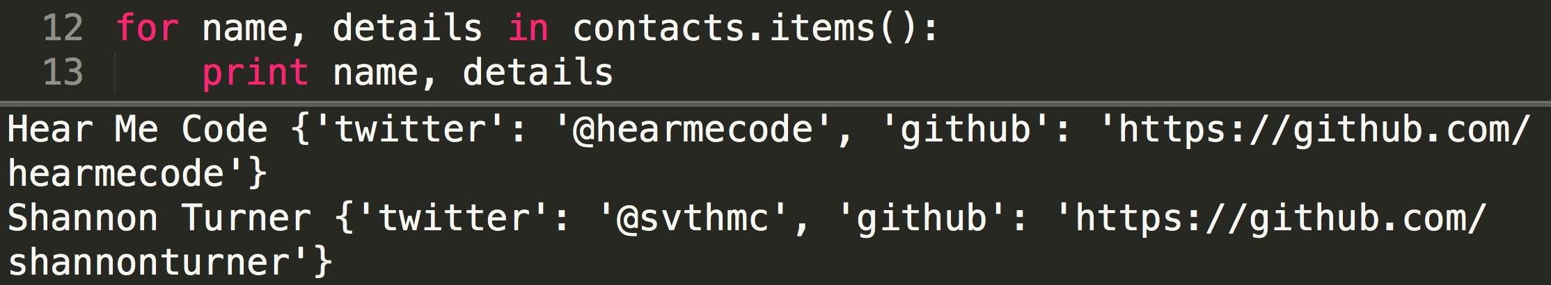
.items( ) creates a nested list
.items() will create a list of all of the key/value pairs in your dictionary.
Notes:
Now I'm using the variables "name" because that's the name of the contact and "details" because that's the information I know about that contact.
Remind everyone that dictionaries are unordered, so you might see things in a different order and that's okay

Slide 65
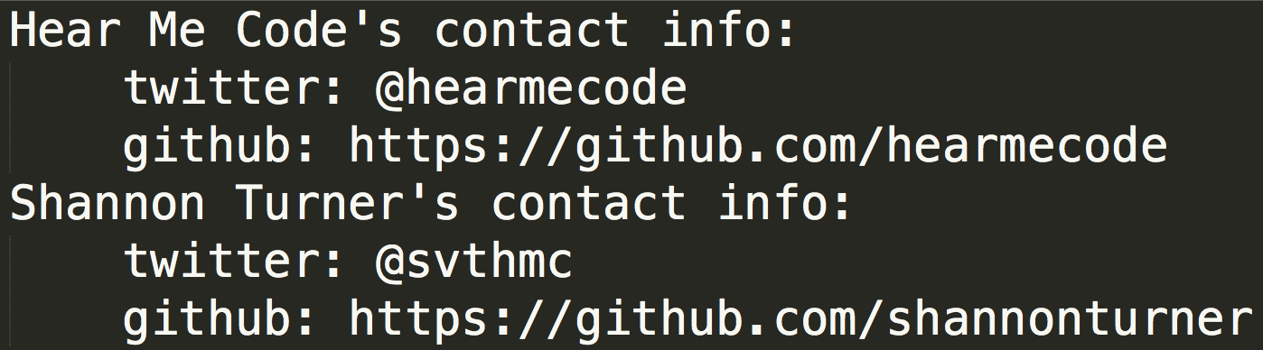
Exercise: part 2
Loop through the contacts dictionary to display everyone's contact information, like this:
Notes:
As a hint, think through how you'll go about looping through a nested dictionary. If it makes it easier, step back and think about how you loop through a nested list.
Make sure you're looping through your dictionary rather than assuming everyone will have a Twitter handle, a GitHub link, and nothing else. Maybe some people in your contact list will have more details. Maybe some will have fewer, or entirely different ones.

Slide 66
playtime!
Check out the Hear Me Code slides repo for practical examples, code samples, and more!
Beginner: US States tables
Beginner: Contacts list
Advanced: Comparing two CSVs

Slide 67
What now?
Lessons 4 & 5
Organize a study group on the listserv
Come be a teaching assistant
Practice, practice, practice
Notes:
Lessons 4 and 5 aren't taught in person anymore but the slides are available for self-study. Lots of people have also self-organized study groups for lesson 4 at the American Art Museum's courtyard and other public places.
Being a teaching assistant is one of the best ways to solidify what you've learned!

